Slide 1
Leslie Fetzer
iNACOL/SREB 2012 National Online Teacher of the Year

Slide 3
-The progressive realization of a worthy ideal.

Slide 4
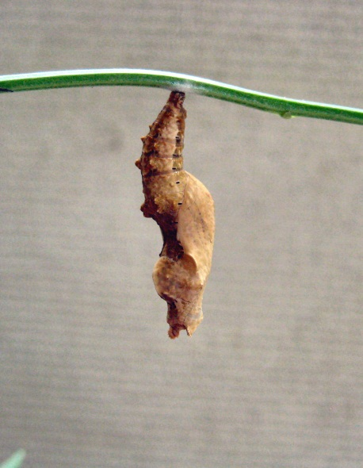
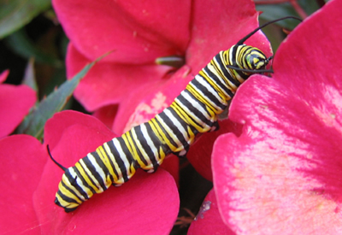

Slide 6
“We make a living by what we get; we make a life by what we give.”
-Winston Churchill

Slide 7
leslie.fetzer@ncpublicschools.gov

